Slide 1

WireIt Presentation http://neyric.github.com/wireit
WireIt version 0.6.0
Eric Abouaf – august 2010

Slide 2
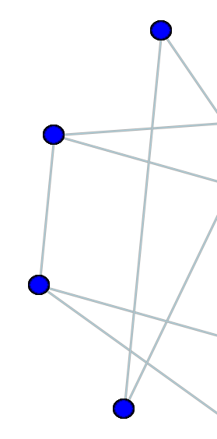
What is it ?
  Javascript framework to create «web wirable interface»
  Uses the YUI Library
  Open source, MIT license
  Supports all major browsers

Slide 3
What's in it ?
PHP /MySQL
backend
Gears backend
WiringEditor
Full-blown interface to create custom visual languages
Adapter Interface
WireIt.Layer
InOutContainer
ImageContainer
FormContainer
Container
InputEx Library
Wire
Terminal
YUI Library

Slide 4
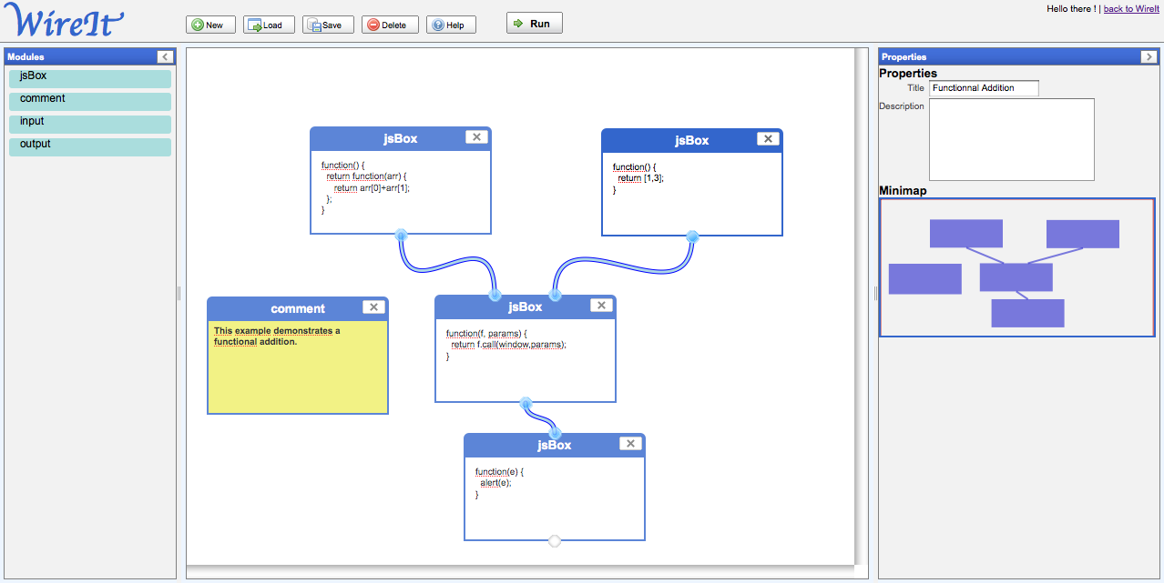
What's it for ?
  Any « wirable interface » :
  Workflow
  Visual Programming
  Dataflow
  Database querying
  Mashups
  Graph editors
  ...

Slide 5

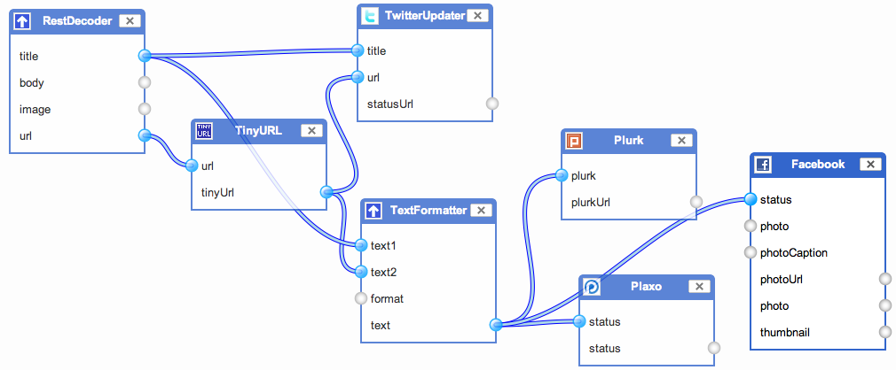
Examples
« tarpipe makes it easy to share content across different social media applications. »

Slide 6
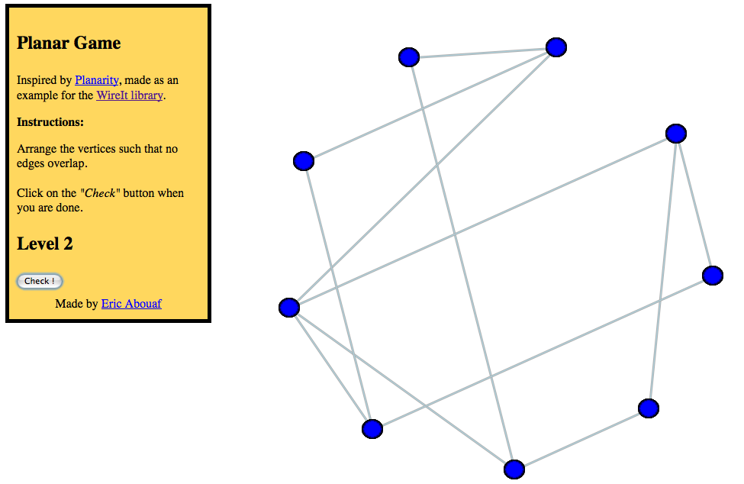
Examples
« The Planar Game: Arrange the vertices such that no edges overlap. »

Slide 7
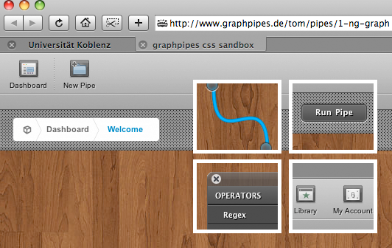
Examples
« Graphpipes is a simple and easy way to aggregate semantic data.
By using drag'n'drop you are able to create SPARQL-queries and reuse them later in your networked graphs. » (proof of concept, early beta)

Slide 8
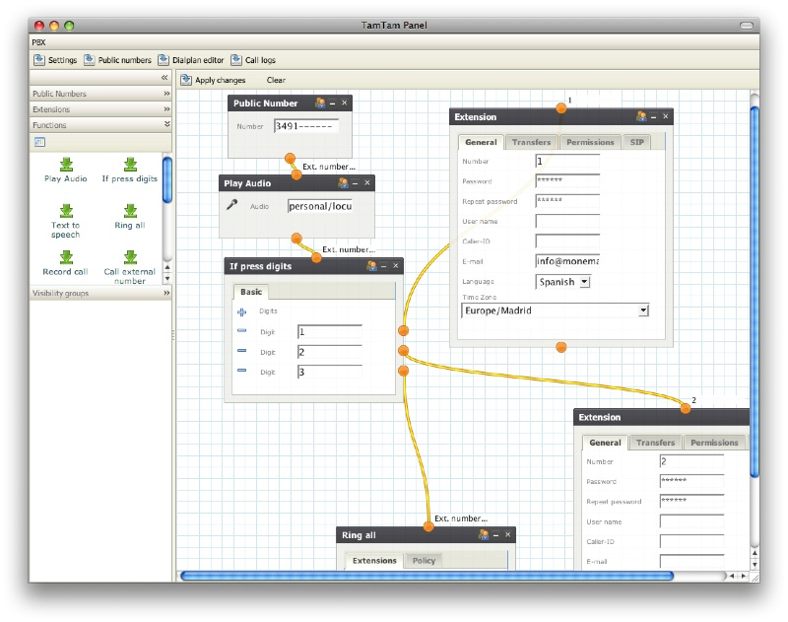
Examples
« PBX Editor: Create voice menus with a few clicks »
(not done with WireIt, just an example...)

Slide 9
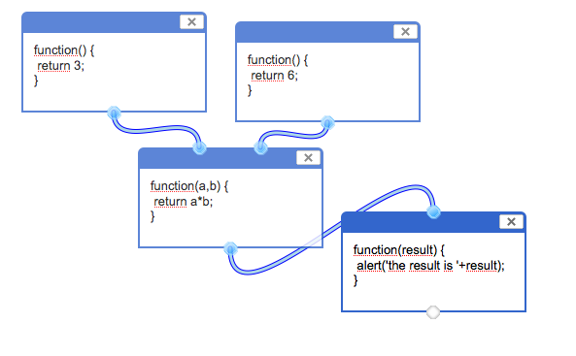
Examples
JsBox: Proof of concept for visual programming

Slide 10
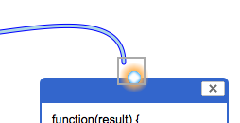
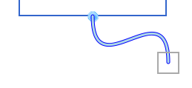

How to edit wires ?
1. Start dragging from a terminal
2. Drop on an other terminal
3. Click on the scissors to cut the wires

Slide 11
How does it work ?
Canvas tag to draw wires with bezier curves
excanvas for IE support
YUI magic
InputEx form library

Slide 12
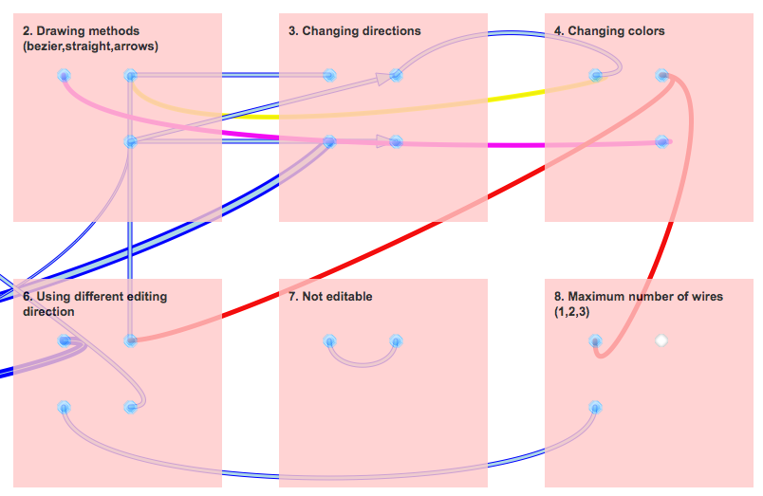
Terminals & Wires properties

Slide 13

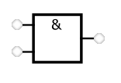
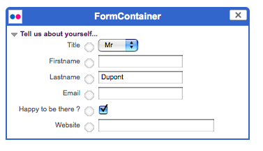
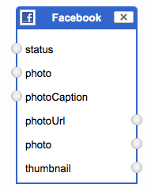
Containers
Image Containers
Form Containers (using inputEx)
Inputs/outputs Containers
+ create your own
Extend the base Container class

Slide 14
WiringEditor
A full-page interface for common WireIt uses.
ToolBar
Module
List
Layer
Properties
Form
Minimap

Slide 15
WiringEditor
A full-page interface for common WireIt uses.
JSON Language Definition
1. Define your visual language
(modules + WiringEditor options)
WiringEditor
DB
storage
2. Edit « wirings » in your language
Adapter
Wiring JSON
3. Process/Interpret/Translate the wiring JSON

Slide 16
JSON Language Definition
{
// Language name
languageName: "jsBox",
// JSON inputEx definition for the properties form
propertiesFields: [
{"type": "string", inputParams: {"name": "name", label: "Title" } },
{"type": "text", inputParams: {"name": "description", label: "Description"} }
],
// JSON Modules definition
modules: [
…
]
}

Slide 17
JSON Module Definition
{
// Module name
"name": "comment",
// Container JSON properties
"container": {
// Container class
"xtype": "WireIt.Container",
// Terminals config :
"terminals": [
{
"name": "inputA",
"direction": [0,1],
"offsetPosition": {"left": 86, "bottom": -15},
"ddConfig": {
"type": "output",
"allowedTypes": ["input"]
}
},
...
],
// Other container options
"title": "Comment",
...
}
}

Slide 18
Wiring JSON - output example
{
// List of module instances
"modules": [
{
"config": { "position": [130,28] },
"name":"myModule1",
},
{
"config": { "position": [270,280] },
"name":"myModule2",
}
],
// List of wire instances
"wires": [
{
"src": { "moduleId":0, "terminal":"out"},
"tgt": { "moduleId":1,"terminal":"in"}
}
],
// Properties form value
"properties": {
"description":"A wiring example",
"name":"ExampleModule"
}
}
myModule1
myModule2

Slide 19
Adapters
Ajax Adapter (REST or custom RPC)
Gears (useful for prototyping)
JSON-RPC (+demo PHP/MySQL backend)

Slide 20
Ressources
  Home page and Download
  http://neyric.github.com/wireit
  The guide
  http://neyric.github.com/wireit/guide.html
  Source repository and bug tracker on GitHub
http://github.com/neyric/wireit/
  Forums
http://groups.google.com/group/wireit/
  Blog
  http://javascript.neyric.com/blog/category/wireit/

Slide 21
Thanks !
Eric Abouaf
eric.abouaf@gmail.com
http://javascript.neyric.com/blog

